Slide 1
Module 3
Finding Differentially Expressed Genes

Slide 2
Outline
Introduction to module
Feature selection methods
Overview of feature selection methods
Filter methods
Wrapper methods
Evaluation of feature selection methods
Evaluation schemes
Feature selection for gene expression data
Selecting differentially expressed genes
Heatmaps and visualizations
Heatmaps
Feature selection with R
R scripts for feature selection from gene expressions data

Slide 3
Learning Objectives
1. Select features from highly dimensional datasets.
2. Evaluate the performance of feature selection methods.
3. Write R scripts to select features from datasets involving gene expressions.

Slide 4
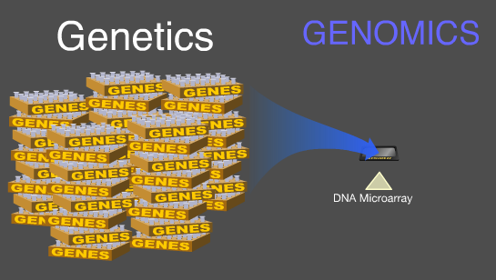
Feature Selection Methods
Feature selection is also called dimensionality reduction and contributes to data reduction.
It is very important in biomedical data due to an often large number of features available – the curse of dimensionality (Ex: number of gene expressions).
Many feature selection methods exist.

Slide 5

Feature Selection Methods

Slide 6
Overview of Feature Selection Methods
Features may be redundant, they may duplicate much of the information contained in the other features (Ex: age and date of birth represent the same information).
Features may be irrelevant, they do not bring valuable information for the data analytics task (Ex: patient ID is not relevant for the analysis).
Features may impede a data analysis method from performing well (overfitting – when the model built fits too closely the dataset, which would degrade its performance on other sets of data).

Slide 7
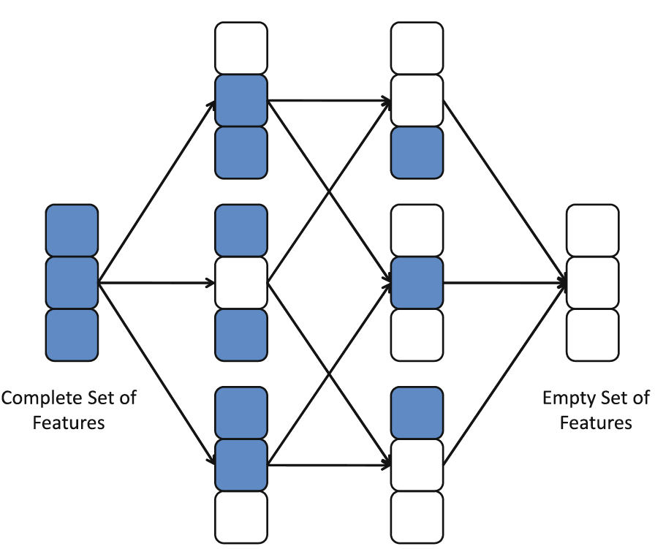
Overview of Feature Selection Methods
Search problem – N features → 2^{N} subsets possible (exponential problem)

Slide 8
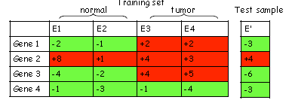
Overview of Feature Selection Methods
Feature selection:
A minimal set of relevant features for future tasks such as diagnosis, treatment etc.
Ex: gene selection for future prediction or assay development

Slide 9
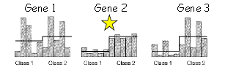
Overview of Feature Selection Methods
Typical variable selection methods – one variable at a time
Examples:
T-test
Correlation coefficient
Between group to within group sum of squares (BSS/ WSS) (Dudoit et al. 2001)

Slide 10
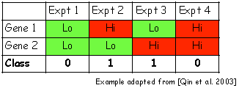
Overview of Feature Selection Methods
Multivariate gene selection
Our goal: Consider multiple genes simultaneously to exploit the interdependence between genes to reduce # relevant genes

Slide 11
Overview of Feature Selection Methods
More generally, feature selection methods belong to several families:
Filter methods where features are selected independently from the data analysis task
Wrapper methods where features are selected based on the resulting performance in the data analysis task
Embedded methods where feature selection is performed during the data analysis task (no as preprocessing).

Slide 12

Overview of Feature Selection Methods
Filter → select features independently from the task of determining whether a duckling is little duck or not
Wrapper → select features that improve the prediction of whether the duckling is a little duck or not.

Slide 13
Overview of Feature Selection Methods
Some methods map the present features to another space where they may become more meaningful.
This method is at the basis of such methods as
support vector machines (SVMs),
signal processing methods such as Fourier transformation or wavelet transformation,
statistical methods such as factor analysis or principal component analysis.

Slide 14
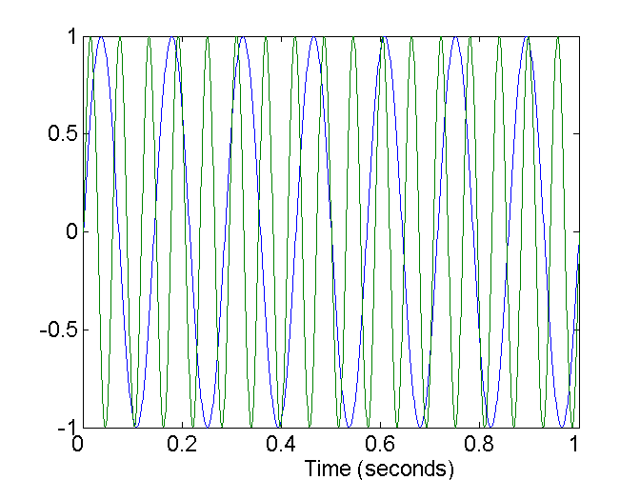
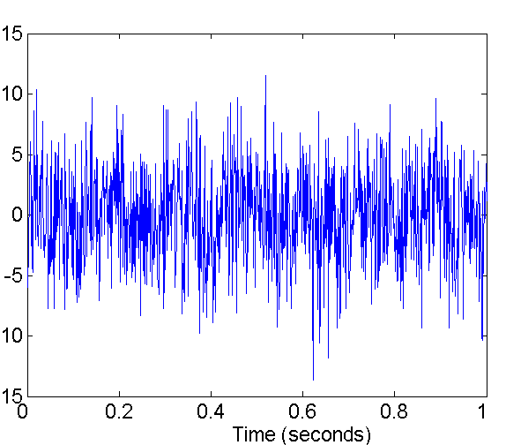
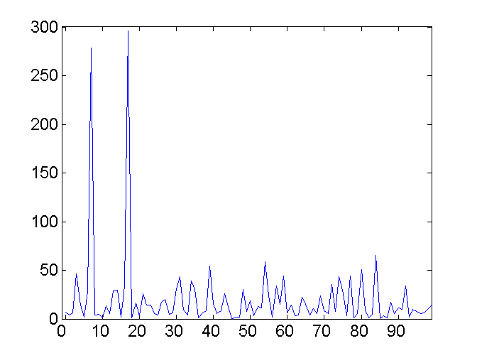
Overview of Feature Selection Methods
Fourier transformation

Slide 15
Filter Methods
Filter methods for features and classes
A class is a predefined label associated to a particular sample.
Ex: two classes: duck / swan
They may measure uncertainty, distance or similarity, dependence, or consistency between classes.
They are independent from the data analytics task and therefore can be applied to several different tasks:
They are more simple than the wrapper methods and consequently are more efficient (take less time and resources).

Slide 16
Filter Methods
Filter methods examples (see module Resources for statistics background)
T-test of a feature between two classes (p-value < 0.05, numeric features).
Correlation coefficient (numeric features) between a feature and a class.
Chi-square (nominal features).
…
They can yield a ranking of features, where features are ranked based on their differences between two classes.

Slide 17
Filter Methods
BSS/WSS (Dudoit et al. 2001)
Between Sum of Squares (BSS) / Within Sum of Squares (WSS)
Two classes A and B, n_{a} samples in A, n_{b} samples in B, m the overall mean, m_{a} the mean in A, m_{b} the mean in B.
BSS = n_{a} (m_{a} - m)² + n_{b} (m_{b} - m)²
WSS = sum _{i in A} (x_{i} - m_{a}) ² + sum _{i in B} (x_{i} - m_{b}) ²
BSS is a measure of separation between the classes, while WSS is a measure of cohesion on each class.
BSS/WSS – ratio between to within groups sum of squares - can be used for ranking features by their discrimination power between two classes.

Slide 18
Between Group Sum of Squares (BSS)
Class A:
Person 1: Height = 170 cm
Person 2: Height = 175 cm
Person 3: Height = 168 cm
Class B:
Person 4: Height = 180 cm
Person 5: Height = 185 cm

Slide 19
Between Group Sum of Squares (BSS)
m = (170 + 175 + 168 + 180 + 185) / 5 = 175.6 cm
BSS = na * (ma - m)² + nb * (mb - m)²

Slide 20
Between Group Sum of Squares (BSS)
na is the number of samples in Class A (3 individuals in this case).
ma is the mean height in Class A (calculated as (170 + 175 + 168) / 3 = 171 cm).
nb is the number of samples in Class B (2 individuals in this case).
mb is the mean height in Class B (calculated as (180 + 185) / 2 = 182.5 cm).
m is the overall mean height (175.6 cm, as calculated earlier).

Slide 21
BSS
BSS = 3 * (171 - 175.6)² + 2 * (182.5 - 175.6)²
≈ 3 * (-4.6)² + 2 * (6.9)²
≈ 3 * 21.16 + 2 * 47.61
≈ 63.48 + 95.22
≈ 158.70

Slide 22
Within Sum of Squares
Class A:
Person 1: Height = 170 cm
Person 2: Height = 175 cm
Person 3: Height = 168 cm
Class B:
Person 4: Height = 180 cm
Person 5: Height = 185 cm

Slide 23
WSS
means for each class, ma for Class A (171 cm) and mb for Class B (182.5 cm), as well as the overall mean m (175.6 cm).
WSS = Σ (xi - mi)²
WSS_A = (170 - 171)² + (175 - 171)² + (168 - 171)²
= 1² + 4² + 9²
= 1 + 16 + 81
= 98

Slide 24
WWS
WSS_B = (180 - 182.5)² + (185 - 182.5)²
= 6.25 + 6.25
= 12.5
WSS = WSS_A + WSS_B
= 98 + 12.5
= 110.5

Slide 25
Wrapper Methods
Wrapper methods select best features for a prediction method.
Example:
Bayesian Model Averaging (BMA) selects best features using Bayesian (probabilistic) method / algorithm.
It is a multivariate variable selection technique.
Typical model selection approaches select a model and then proceed as if the selected model has generated the data --> overconfident inferences
Some advantages of BMA are:
Fewer selected genes
Can be generalized to any number of classes
Posterior probabilities for selected genes and selected models.

Slide 26

Wrapper Methods
BMA averages predictions from several models (Yeung, Bumgarner, Raftery 2005)
Pre-processing step: Rank genes using BSS/WSS ratio.
Initial step:
Repeat until all genes are processed:
Output: selected genes and models with their posterior probabilities.

Slide 27
Wrapper Methods
Wrapper can search for best features according to several search methods involving search direction, search strategy, and evaluation measure:
Exhaustive tests all combinations of features.
Best first selects first the best overall features and builds on these.
Step wise adds or removes features one by one as long as each improves on the prediction task.
Step wise can go forward (starts from an empty set and adds features one by one) or backward (starts from all features and removes them one by one).

Slide 28
Outline
Introduction to module
Feature selection methods
Overview of feature selection methods
Filter methods
Wrapper methods
Evaluation of feature selection methods
Evaluation schemes
Feature selection for gene expression data
Selecting differentially expressed genes
Heatmaps and visualizations
Heatmaps
Feature selection with R
R scripts for feature selection from gene expressions data

Slide 29
Evaluation of Feature Selection Methods
Evaluation of the best feature subset can take several approaches, the main ones being:
Comparison of prediction performance.
Robustness testing.
Efficiency (time and resource comparison).
Value added (feature ranking, feature posterior probability, feature weighting).

Slide 30
Outline
Introduction to module
Feature selection methods
Overview of feature selection methods
Filter methods
Wrapper methods
Evaluation of feature selection methods
Evaluation schemes
Feature selection for gene expression data
Selecting differentially expressed genes
Heatmaps and visualizations
Heatmaps
Feature selection with R
R scripts for feature selection from gene expressions data

Slide 31
Evaluation Schemes
Prediction performance
Compare the predictive power of the subset of predictive genes using the predictive task – or several of them - and determine
Which is the best feature subset, or
Whether the feature subsets perform better than the complete set of features.

Slide 32
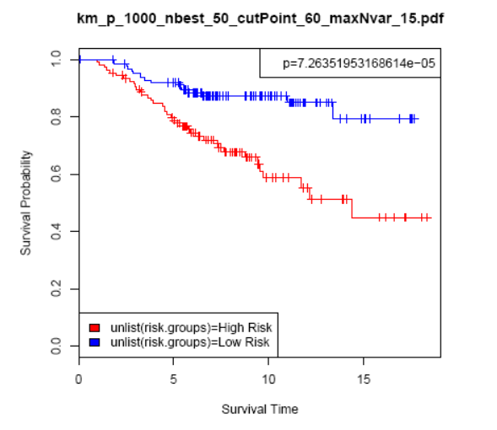
Evaluation Schemes
Prediction performance (Annest, Bumgarner, Yeung 2009)
Genes selected for a high-risk group (red) in comparison with a low-risk group of breast cancer patients
Survival curve between the two groups is significant (p-value < 0.05)
We conclude that the genes / features selected add a value to the task of predicting the severity of this disease.
cBioPortal can be used to perform this analysis once genes have been selected.

Slide 33
Evaluation Schemes
Prediction performance (Bichindaritz, 2010)
Often feature selection methods compare themselves with one another by selecting the smallest feature subset that maximizes performance.

Slide 34
Evaluation Schemes
Robustness testing
Consists in testing how well the feature set selected resists noise.
Obtained by adding noise (slightly modifying) the feature values and seeing whether the feature set remains unchanged.
Can participate in avoiding overfitting.

Slide 35
Outline
Introduction to module
Feature selection methods
Overview of feature selection methods
Filter methods
Wrapper methods
Evaluation of feature selection methods
Evaluation schemes
Feature selection for gene expression data
Selecting differentially expressed genes
Heatmaps and visualizations
Heatmaps
Feature selection with R
R scripts for feature selection from gene expressions data

Slide 36
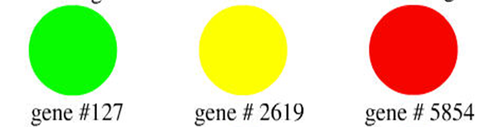
Feature Selection for Gene Expression Data
Differential gene expression aims at determining whether different genes are expressed in patients of different medical conditions, or between patients and normal subjects.
Non expressed Intermediate Overexpressed

Slide 37
Outline
Introduction to module
Feature selection methods
Overview of feature selection methods
Filter methods
Wrapper methods
Evaluation of feature selection methods
Evaluation schemes
Feature selection for gene expression data
Selecting differentially expressed genes
Heatmaps and visualizations
Heatmaps
Feature selection with R
R scripts for feature selection from gene expressions data

Slide 38
Outline
Introduction to module
Feature selection methods
Overview of feature selection methods
Filter methods
Wrapper methods
Evaluation of feature selection methods
Evaluation schemes
Feature selection for gene expression data
Selecting differentially expressed genes
Heatmaps and visualizations
Heatmaps
Feature selection with R
R scripts for feature selection from gene expressions data

Slide 39
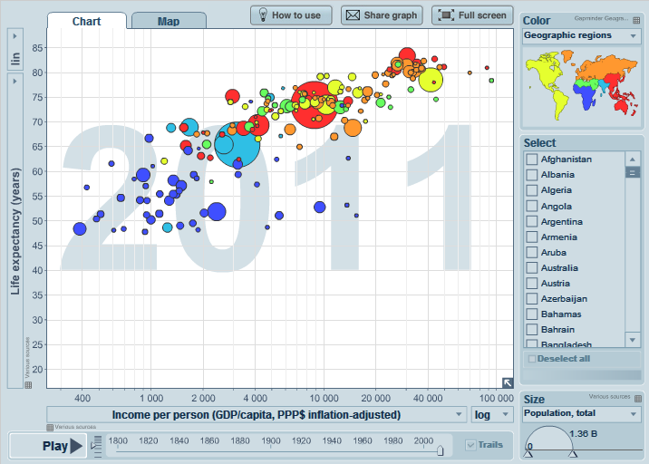
Heatmaps and Visualizations
Visualizations play a major role for understanding the data, exploring the data, and interpreting the results of data analysis.
Visualization methods include:
Histograms
Scatterplots
Boxplots
Survival curves (Kaplan Meyer)
Heatmaps
etc.

Slide 40
Outline
Introduction to module
Feature selection methods
Overview of feature selection methods
Filter methods
Wrapper methods
Evaluation of feature selection methods
Evaluation schemes
Feature selection for gene expression data
Selecting differentially expressed genes
Heatmaps and visualizations
Heatmaps
Feature selection with R
R scripts for feature selection from gene expressions data

Slide 41
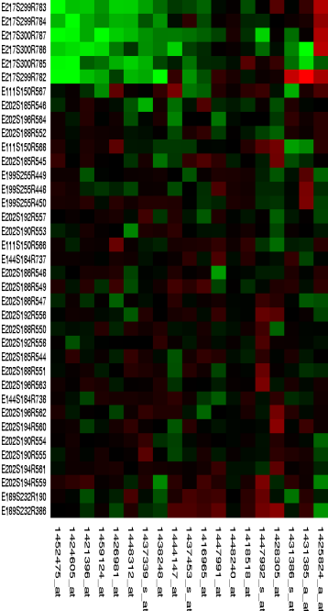
Heatmaps
A heatmap is a visualization of expression levels of features (genes etc.) using a color scale.
In general, features are in rows and sample in columns.
They are often combined with some clustering to group either patients in classes or features in groups, which is represented by a tree at the top and/or the side.

Slide 42
Outline
Introduction to module
Feature selection methods
Overview of feature selection methods
Filter methods
Wrapper methods
Evaluation of feature selection methods
Evaluation schemes
Feature selection for gene expression data
Selecting differentially expressed genes
Heatmaps and visualizations
Heatmaps
Feature selection with R
R scripts for feature selection from gene expressions data

Slide 43

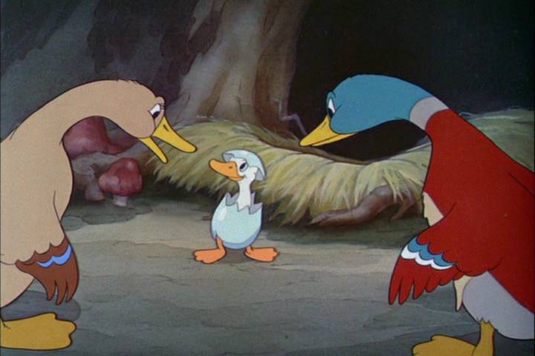

Feature Selection with R
Use R to select features.
Overfitting considerations.

Slide 44
Outline
Introduction to module
Feature selection methods
Overview of feature selection methods
Filter methods
Wrapper methods
Evaluation of feature selection methods
Evaluation schemes
Feature selection for gene expression data
Selecting differentially expressed genes
Heatmaps and visualizations
Heatmaps
Feature selection with R
R scripts for feature selection from gene expressions data

Slide 45
R Scripts for Feature Selection
Watch the video
Start Jupyter notebook from the provided link

